Slide 1

Cyber-security Considerations for Safety Critical Systems
From
Team 16
Paul Earhart, Haoran Geng,
Dustin Kline, Larry Kozlowski, Daniel Moreno

Slide 2
Introduction:
The Controller Area Network (CAN bus)
Testing and documenting the inherent cyber-security of a CAN bus
Demonstrate everything that was learned about CAN bus cyber-security to interested members of Rolls-Royce

Slide 3
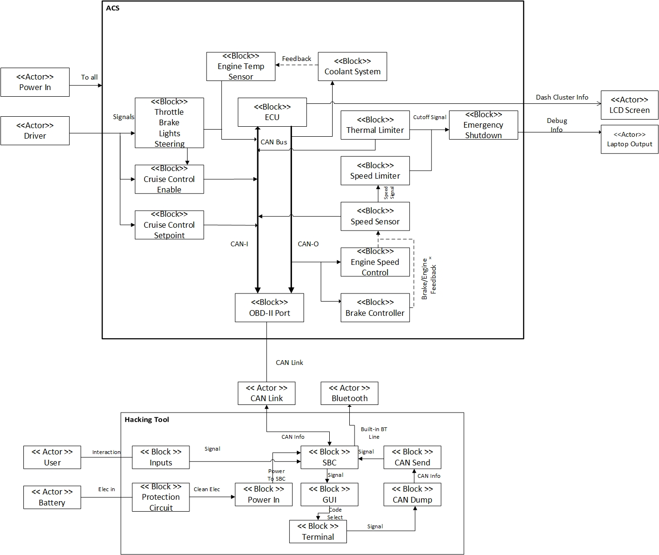
Our solution

Slide 4
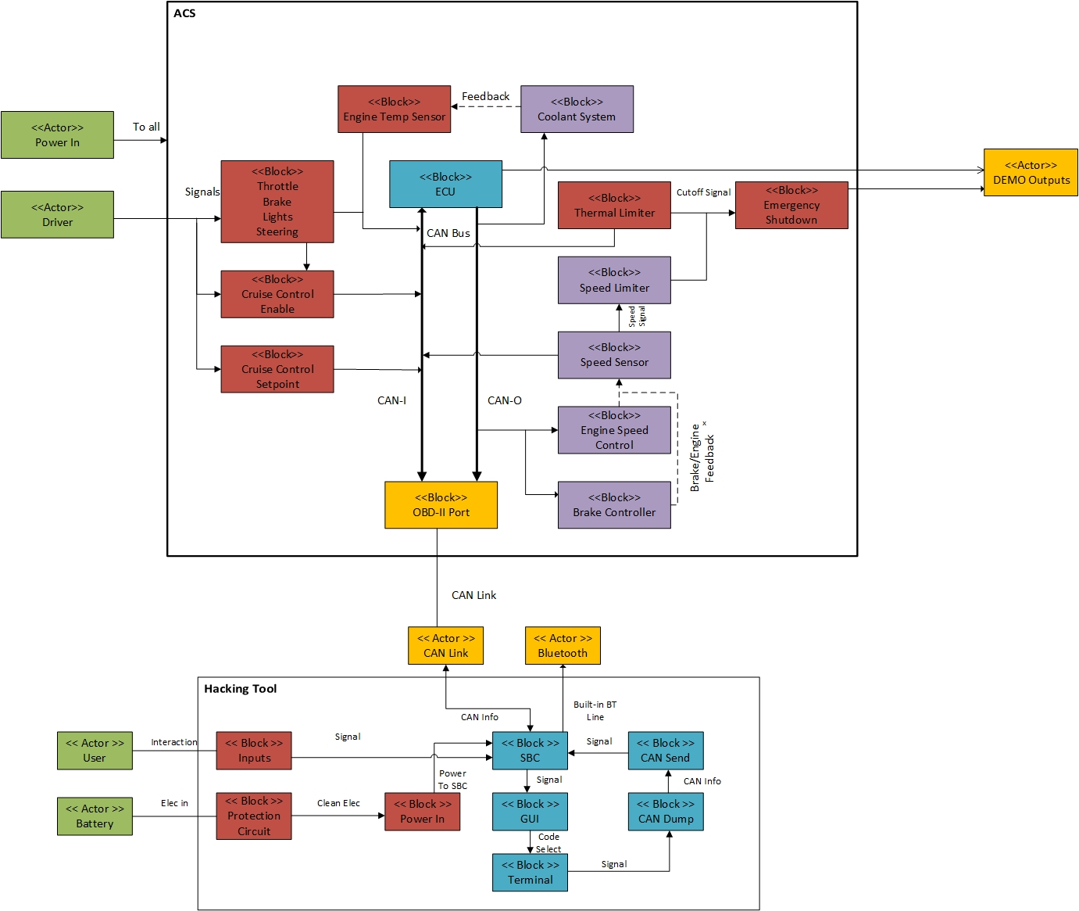
Base System

Slide 5
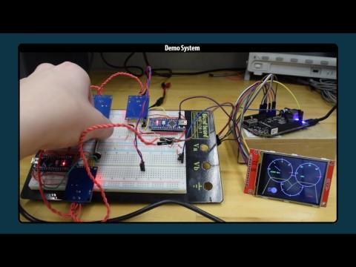

Slide 6
Attack System

Slide 7
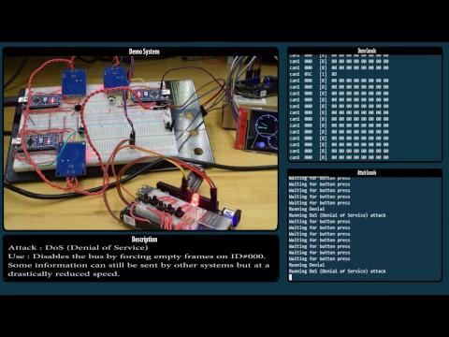

Slide 9
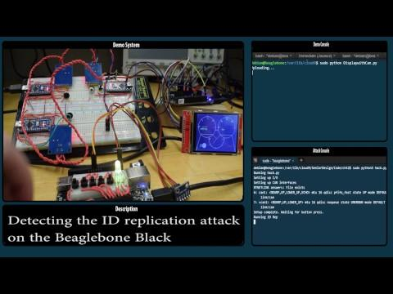
Hardened System

Slide 10
CAN-BUS Encryption
Inheriting the knowledge gained by Team 16, research possible implementations of CAN-BUS encryption.
Design goals:
Make it impossible for some external entity to successfully impersonate one of the nodes in the BUS.
Protect the confidentiality of messages sent through the BUS.
Minimize the hit to performance done by the encryption techniques.

Slide 11
The biggest challenge:
Key agreement
Design 1: Public-Key Cryptography.
Drawbacks: slow
Pros: standard practice, safe, relatively simple to implement.
Design 2: Implement CHAP (Challenge-Handshake Authentication Protocol)
Drawbacks: harder to implement.
Pros: very fast

Slide 12
Project Deliverables
A practical implementation of both of these designs.
An extensive analysis of both implementations, discussing their strong points and weak points, backed by data gathered through testing.

Slide 13
Going Further Material
Wireless hacking
More powerful central computer
Larger things like aircraft
Reduce redundancy

Slide 14
Conclusion

